Slide 1

1st Meeting
Course Overview & Opening

Slide 2

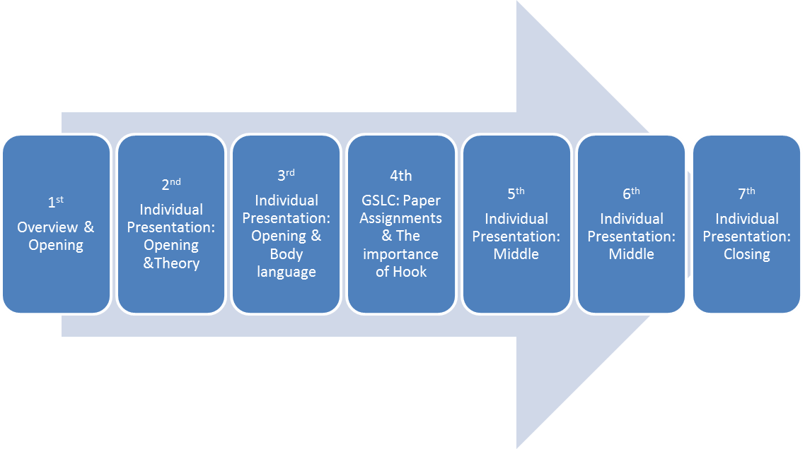
Class Activities
BEFORE UTS

Slide 3
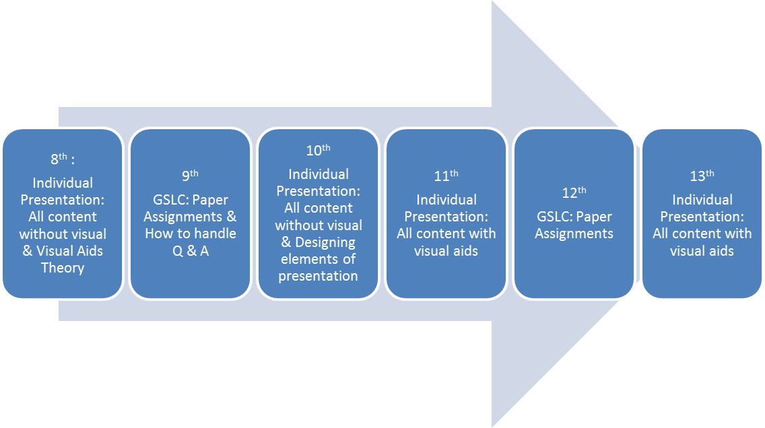
Class Activities
BEFORE UAS

Slide 4
Class Assessment
Paper + Presentation
^{TM (30%)} = Practice about Opening, Middle, and Closing, and also GSLC Paper assignment.
^{UTS (30%) =} Presentation (free topic) without any visual aids
^{UAS} (40%) = Presentation (business topic) with visual aids + Submit an outdoor presentation video.

Slide 5
The Organization
Opening: Use the right hook!
  What: A hook is a statement, a picture, a demonstration, an audio-video display, or an object used specifically to get attention
  Why: it makes your audience to expect more
  How: find the most unusual/interesting/dramatic part in your subject. Use a rhetorical question, start with an interesting fact/statistics, give a problem to think about, tell a story/anecdote

Slide 6
The Organization
Middle: Keep the logical, chronological and/or step-by-step connections!
  What: ‘Logical’ refers to degrees of difficulty, ‘chronological’ to time sequence, and ‘step-by-step’ to stage/phase sequence
  Why: the more logical & chronological, the easier your audience follow & remember your message
  How: arrange your subject from the least to the most difficult topics, make sure the sub-topics in harmony with the objective, and never make your audience follow you with extra efforts…

Slide 7
The Organization
Closing: Move your audience!
  What: Allow your audience to understand/feel, remember, and act on your final message
  Why: it is the most memorable part of your whole message
  How: use wrap-up questions, quote a saying from a well-known person, refer back to the beginning of the story, or call your audience into action

Slide 8
The Organization
Closing: Move your audience!
  What: Allow your audience to understand/feel, remember, and act on your final message
  Why: it is the most memorable part of your whole message
  How: use wrap-up questions, quote a saying from a well-known person, refer back to the beginning of the story, or call your audience into action

Slide 9
Opening a presentation
Welcoming the audience
It is the most important part of a presentation
It gives the first impression
Expression used:
Good morning/ afternoon, ladies and gentlemen!
Hello / hi everyone!
First of all let me thank you all for coming here today!
I’m happy / delighted that so many of you could make it today!

Slide 10
Opening a presentation
Introducing yourself
The amount of information you give about yourself and your work and the level of formality you use depends on the presentation you are giving
Expression used:
Let me introduce myself. I’m Dave Elwood from…
For those of you who do not know me, my name’s…..
Ad you probably know, I’m the new manager of….
I’m head of logistics here at Air Spares.
I’m here in my function an the head oh Controlling.

Slide 11
Opening a presentation
Define the situation
Tell the audience your destination- the reason they’re there to listen to you and the purpose of your presentation
If the audience do not know the reason they won’t have any reason to accompany you along your journey
Explain why the topic is relevant for your audience
Expression used
My talk is particularly relevant to those of you/us who….
My topic is very important for you because…
By the end of this talk you will be familiar with…..

Slide 12
Opening a presentation
The structure of a presentation
The main part :
Introduction (part tell the audience what you are going to say)
Main part (say it)
Conclusion (tell them what you said)
Expression:
Today I would like to tell you about our new plan.
This morning I would like to bring you up to date on our department
I’ll begin by explaining the function
I’m going to talk to you today about new development in the sales department
After that, I’ll move on to my next point
I’ll be talking about our guidelines for internet use
During the next hour we’ll be looking at the advantages of this system

Slide 13
Opening a presentation
Structuring a presentation
The most common way to structure a presentation is to have three parts and sub divide them into (three) smaller section
Expression:
I’ve divided my presentation into three (main) parts: x, y, z
In my presentation I’ll focus on three major issues
First (of all), I’ll be looking at.., second.., and third..
I’ll begin / start off by explaining….
Then / next / after that, I’ll go on to…
Finally, I’ll offer some solution.

Slide 14
Opening a presentation
Structuring a presentation
After you tell about your sub topics, don’t forget to tell about how much time do you need to finish your presentation.
Expression:
My presentation will take about 5 minutes.
It should take about 30 minutes to cover these issues.

Slide 15

Thank You !

